Slide 1
陈鹏飞
数据科学与计算机学院
2018-06-06
chenpf7@mail.sysu.edu.cn

Slide 2
Lecture 13 — Communication
Pengfei Chen
School of Data and Computer Science
June 06, 2018
chenpf7@mail.sysu.edu.cn

Slide 3
Outline
Communication Protocols
Client/Server Communication
Group Communication
Event Service
Summary

Slide 4
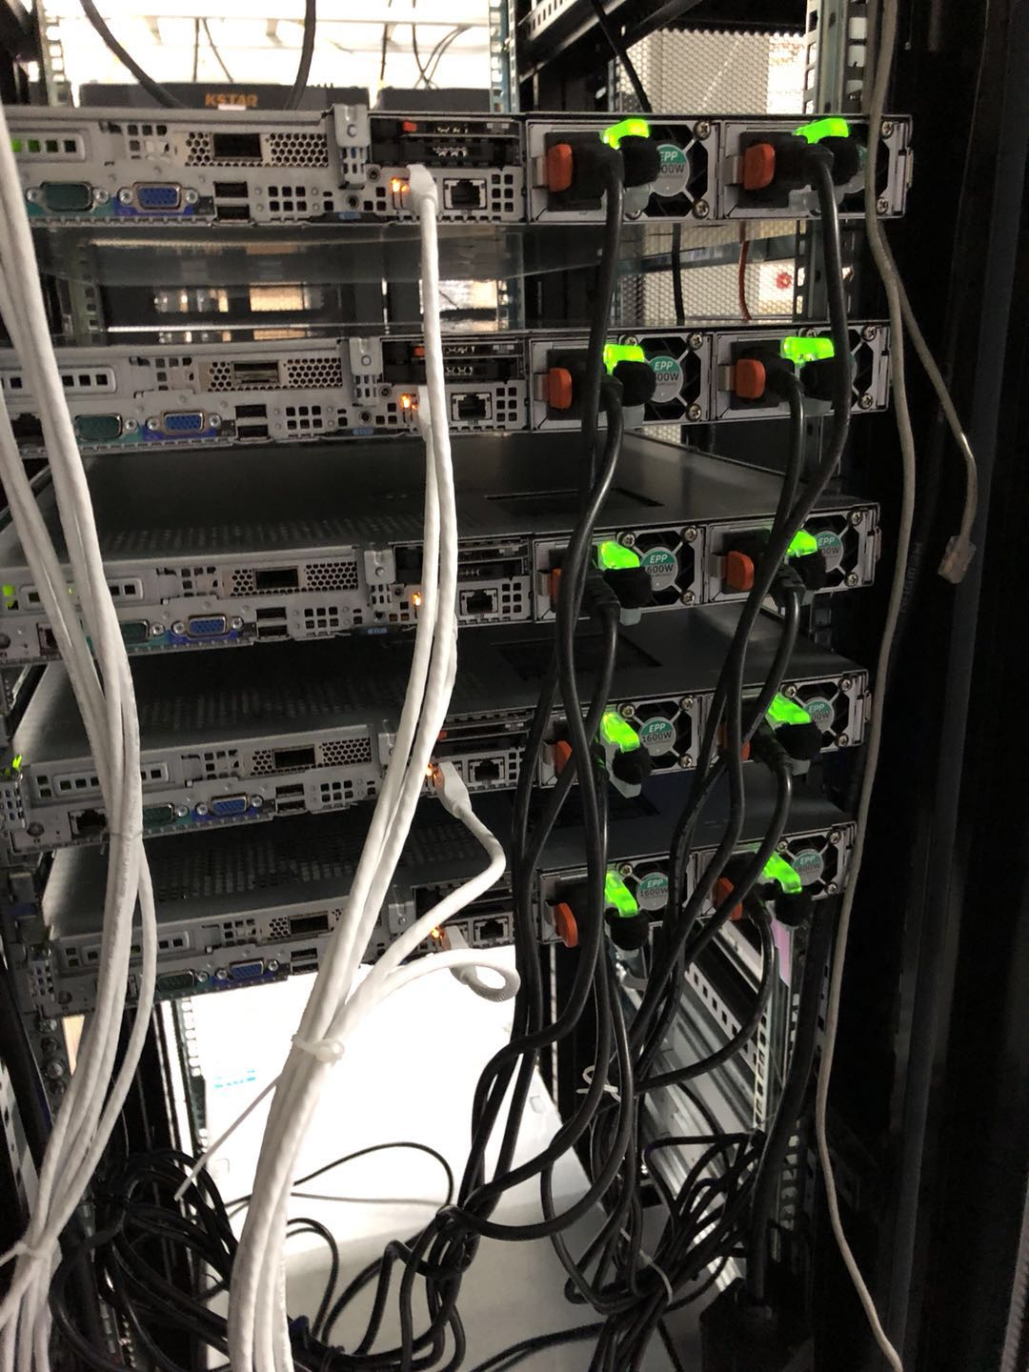
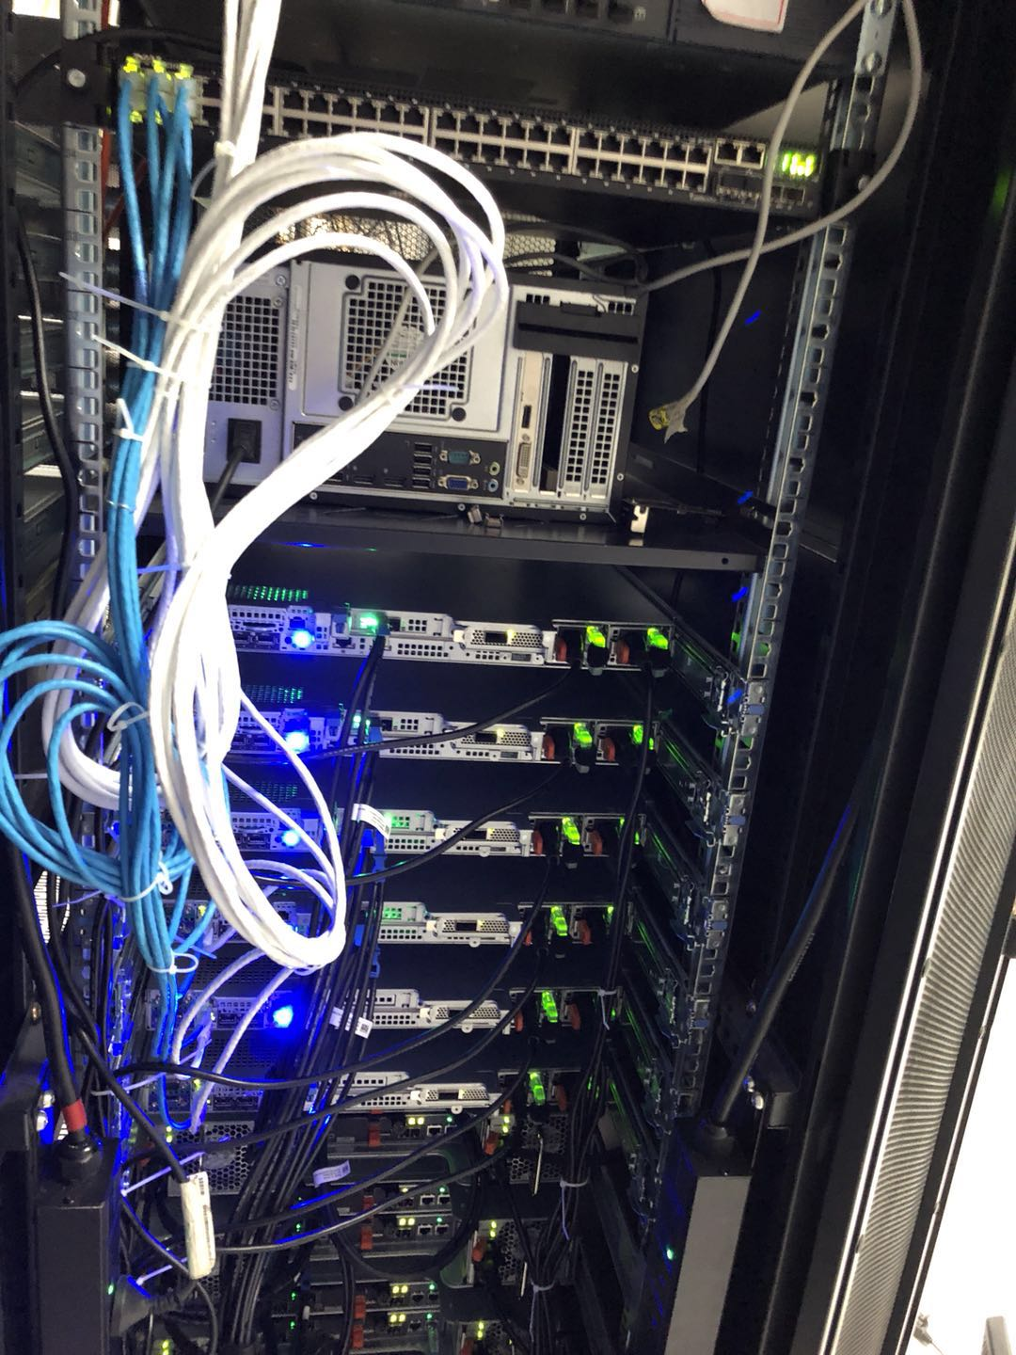
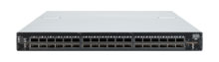
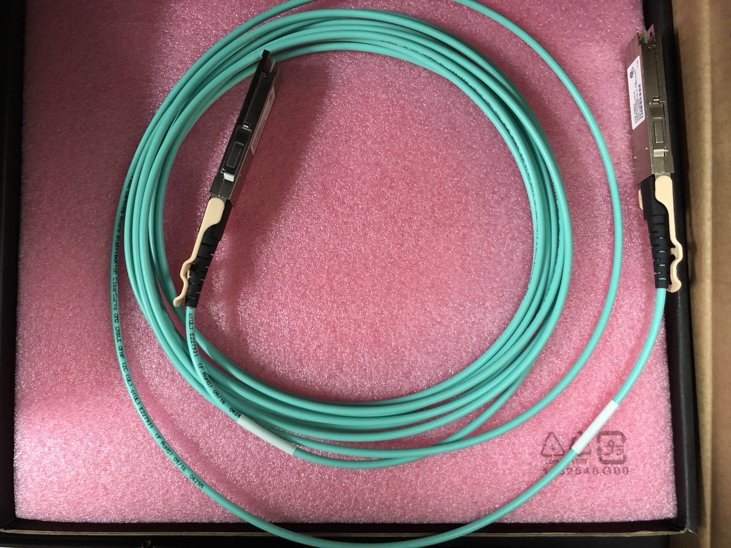
Our Cluster
GPU Cluster
IB Switch
CPU Cluster

Slide 5
Complexity and Heterogeneity
intranet
%
ISP
%
%
%
backbone
satellite link
desktop computer:
server:
network link:
Notes:
Communications in networks, such as Internet, require a standard protocol to handle complexity and heterogeneity.

Slide 6
Heterogeneous Network Performance
Example
Range
Bandwidth
Latency
(Mbps)
(ms)
Wired:
LAN
Ethernet
1-2 kms
10-1000
1-10
WAN
IP routing
worldwide
0.010-600
100-500
MAN
ATM
250 kms
1-150
10
Internetwork
Internet
worldwide
0.5-600
100-500
Wireless:
NFC
ISO/IEC 14443
0.1 – 0.2m
0.4 – 0.5
1-10
WPAN
Bluetooth (802.15.1)
10 - 30m
0.5-2
5-20
WLAN
WiFi (IEEE 802.11)
0.15-1.5 km
2-54
5-20
WMAN
WiMAX (802.16)
550 km
1.5-20
5-20
WWAN
GSM, 3G phone nets
worldwide
0.01-02
100-500
Notes:
Modern networking systems are totally heterogeneous. They include various communication range, bandwidth, and latency.
Communication protocols are designed to handle the heterogeneity of the networks. The most famous protocol standard is the ISO/OSI 7-layer protocol.

Slide 7
Conceptual Layering of Protocol (协议分层)
Message sent
Message received
Layer n
Layer 2
Layer 1
Sender
Communication
Recipient
Medium(介质)
The semantics of the message degrades, to packets, to signals!
Notes:
To handle heterogeneous networks, protocols are required for senders and recipients to exchange messages through the underlying communication medium. As the networks are very complicated, protocols are often designed with various layers, where higher layers are built on top of lower layers, and each layer has its own devoted goals and tasks.

Slide 8
The ISO/OSI 7-Layer Protocol
The ISO/OSI
Reference Model:
Application
HTTP, FTP, Telnet
Presentation
XDR, CDR
Secure Sockets
Message
for connection-
oriented comm.
Session
Transport
message;
TCP, UDP
Network
packet;IP;
ATM VC
Packets
Data link
error-free trans.
Signal
Physical
ISDN, baseband
signaling
Notes:
This slide depicts the well-known ISO/OSI 7-layer protocol, where complicated communications can be handled in a reference model.
Application layer: Protocols that are designed to meet the communication requirements of specific applications, often defining the interface to a service. (HTTP, FTP, Telnet, SMTP, CORBA IIOP)
Presentation layer: Protocols at this level transmit data in a network representation that is independent of the representations used in individual computers. Encryption is performed in this layer if needed. (XDR, CORBA Data Representation, encryption)
Session layer: At this level communication between processes is established and error recovery is performed. It is not required for connectionless communication.
Transport layer: This is the lowest level at which messages (rather than packets) are handled. Messages are addressed to communication ports, Protocols in this layer may be connection-oriented or connectionless. (TCP, UDP)
Network layer: Transfers data packets between computers in a specific network. In a WAN or an inter-network this involves the generation of a route passing through package switching exchanges (PSEs) or routers. In a single LAN no routing is required. (X.25, IP)
Data link layer: Responsible for error-free transmission of packets between computers that are directly connected. In a WAN the connections are between pairs of PSEs and PSEs and hosts. In a LAN they are pairs of hosts. (PPP, Ethernet: CSMA/CD)
Physical layer: The circuits and hardware that drives the network. It transmits sequences of binary data by analogue signaling, using amplitude or frequency modulation of electrical signals, light signals or electromagnetic signals. (ISDN, Ethernet: baseband signaling)

Slide 9
ISO/OSI Transport Layer
Level 4 of ISO/OSI reference model.
Concerned with the transport of information through a network.
Two facets in UNIX networks:
TCP
UDP
Application
Presentation
Session
Transport
connection oriented
virtual connection
sequencing &
acknowledgement
Network
connectionless
up to 64k bytes datagram
no seqs and acks
Data link
Physical

Slide 10
ISO/OSI Transport Layer (TCP)
Transmission Control Protocol (TCP) provides bi-directional stream of bytes between two distributed components.
Reliable but slow protocol. （检测丢失包）
Buffering at both sides decouples computation speeds （协调两个计算速度不同的进程）.
Maximum transfer unit (MTU): the maximum length of a message that can be delivered in a packet.
Notes:
The TCP protocol provides the session layer of one component with a facility to send unstructured data into a stream and another distributed component can read the data from the stream again. At the same time that component can write unstructured data to be returned into that stream so that the first component can read the result.
TCP has to decompose data that is written into the stream into packages that can be transmitted by the network layer and compose the packages again at the other end. As some network protocols (such as IP) may not retain the order with which packages are sent, TCP must sort the packages before they can be composed into a readable stream.
The connection between the two distributed components must be established by the session layer before the bi-directional stream can be used and it has to be destroyed when the stream is no longer required. This is what happens if you issue an rlogin command to a remote host, of which have to provide the address.
TCP provides the presentation layer with a reliable protocol, because the protocol will detect lost packages (during sorting them).
As the two ends connected by the stream may have a different computation speed, TCP buffers the stream so that the two processes are (partially) decoupled.
The network-layer protocol packets consist of a header and a data field. In most network technologies, the data field is variable in length, with the maximum length called the maximum transfer unit (MTU). If the length of a message exceeds the MTU of the underlying network layer, it must be fragmented into chunks of the appropriate size, with sequence numbers for use on reassembly, and transmitted in multiple packets.

Slide 11
ISO/OSI Transport Layer (UDP)
User Datagram Protocol (UDP) enables a component to pass a message containing a sequence of bytes to another component.
Other component is identified within message.
Unreliable but very fast protocol.
Restricted message length (usually 64K bytes).
Queuing at receiver.
Usage Scenarios?
Device to Device communication, Broadcast …
Notes:
UDP provides the presentation layer of a component with the capability to send messages containing unstructured data to the presentation layer of an identified other distributed component.
Depending on the message size of the UDP implementation (usually 64 KBytes) and the package size supported by the underlying network (8KBytes in IP networks), the UDP implementation has to decompose messages into one or more network packages.
Efficient because no overhead for connection establishment if only a few messages are to be exchanged.
UDP is unreliable because it does not detect messages that are lost completely.
UDP queues messages in the order of arrival at the receiving component.
TCP is often used for bulk data transfer where the overhead of establishing a communication link is small compared to the number of packets that the network has to exchange. UDP is often used for client/server communication that usually involves only a small number of packets to be sent back and forth.

Slide 12
TCP/IP Layers in Internet
Message
Layers
Application
Messages (UDP) or Streams (TCP)
Transport
UDP or TCP packets
Internet
IP datagrams
Network interface
Network-specific frames
Underlying network
Notes:
In today’s Internet, TCP/IP approach is employed. TCP/IP layers in Internet is designed in a 5-layer protocol.

Slide 13
ISO/OSI Presentation Layer
At application layer: complex data types
How to transmit complex values through transport layer?
Presentation layer issues:
Complex data structures
Heterogeneity.
Application
Presentation
Session
Transport
Network
Data link
Physical
Notes:
Complex data types are defined in the application layer.
Transmitting the complex values through the transport layer is required.
Issues in the presentation layer include the transformation of complex data structures and heterogeneous data representation on different hardware platforms.

Slide 14
ISO/OSI Presentation Layer
Notes:
Today most communication systems can be viewed as there are middleware layers to handle the communication requirements of applications and services, where fundamental UDP and TCP protocols are in place.

Slide 15
Complex Data Structures
Marshaling（封装）: assemble data structures into a transmittable form
Unmarshaling（解封装）: Re-assemble the complex data structure.
Notes:
Marshaling is the process of taking a collection of data items and assembling them into a form suitable for transmission in a message. It consists of both the flattening of a structured data items into a sequence of basic data items and the translation of those data items into an external data representation.
Unmarshaling is the process of disassembling them on arrival to produce an equivalent collection of data items at the destination. It consists of the translation from the external data representation to the local one and the unflattening of the data items.
Marshalling by hand: A simple way of marshalling by hand is to convert the items to an array of ASCII characters before transmission. For example, flat ASCII data
“5 Smith 6 London 1934”
can represent message like (in Sun External Data Representation XDR 4-byte objects):
5 length of sequence
”Smit” part of string
“h___” part of string
6 length of sequence
“Lond” part of string
“on__” part of string
1934 unsigned long integer

Slide 16
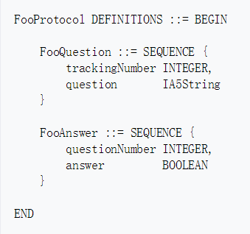
Heterogeneity
Heterogeneous data representation on different hardware platforms.
Approach 1 (Example CDR， Common Data Representation ):
Define a shared representation,
For each different platform, provide mapping between common and specific representation.
Approach 2 (Example ASN):
Abstract syntax notation （抽象语法标记定义抽象数据类型形式的标准,是用于描述数据表示、传输和编码的记法.）
Notation to include type definition.
Notes:
Different hardware and operating system platforms use different representations for elementary data types such as integers and characters:
Most modern operating systems represent 16-bit integers as two bytes, where the most significant byte comes first. Older machines, such as IBM mainframes, represent these integers exactly the other way around.
There are also different encodings for character sets. Characters may be encoded as 7-bit ASCII, in the ISO 8-bit character set or in the emerging 16-bit representation, which accounts for the representation of Asian characters as well.
Distributed operating systems resolve these differences within the presentation layer so as to enable heterogeneous components to communicate with each other.
There are different approaches. One is to convert data during marshalling into a common and well defined representation. An example of this is Sun´s External Data Representation, which is used in most RPC implementations.
Another approach is the abstract syntax notation ASN.1 that was standardized by the CCITT. It provides a notation for including the type definition together with each value into the marshaled representation.

Slide 17
Common Data Representation (CDR)
Presentation layer implementation to support heterogeneity in CORBA (Common Object Request Broker Architecture).
Mapping of application layer data types to transport byte stream.
Encodings of
primitive types
constructed types
interoperable object references
Notes:
CORBA Common Data Representation (CDR) is the external data representation defined with CORBA (Common Object Request Broker Architecture).
CDR defines how application layer data types are represented in a byte stream and achieves an unambiguous definition of the message across different hardware platforms that may use different number representation or character encodings.
There are 15 primitive types: short (16-bit), long (32-bit), unsigned short, unsigned long, float (32-bit), double (64-bit), char, boolean (TRUE, FALSE), octet (8-bit), and any (which can represent any basic or constructed type). The constructed types are shown in the next slide.

Slide 18
CDR Message
index in
notes
sequence of bytes
4 bytes
on representation
0–3
5
length of string
4–7
"Smit"
‘Smith’
8–11
"h___"
12–15
6
length of string
16–19
"Lond"
‘London’
20-23
"on__"
24–27
1934
unsigned long
The flattened form represents a
Person
struct with value: {‘Smith’, ‘London’, 1934}
Notes:
This slide shows a message in CORBA CDR that contains the three fields of a struct whose respective types are string, string and unsigned long. It shows the sequence of bytes with four bytes in each row.
The representation of each string consists of an unsigned long representing its length followed by the characters (assuming 1 byte for each character) in the string.
Although the example is simple, it can represent any data structure that can be composed from the primitive and constructed types, but without pointers.

Slide 19
Heterogeneous Data Representation
Examples of Heterogeneity
Different encoding schemes for character set
Different ways complex data types are implemented by run-time environment of programming languages
Resolution: Standardized Data Representation
Resolution: Application-Level Transport Protocol (xml, json, SGML)
Resolution: Virtual Machines （JVM）
Notes:
Data heterogeneity include different data representation formats due to different hardware or different representations of complex data structures in run-time environments of different programming languages.
A ‘big-endian’ representation vs. a ‘little-endian’ representation of integer is seen in the next slide.
Different encoding schemes for character sets include the 8-bit Extended Binary Coded Decimal Interchange Code (EBCDIC), 7-bit American Standard Code for Information Exchange (ASCII), extended 8-bit ISO-8859-1 Latin-1 character set, and the 16-bit Universal Character Set (UCS).
The Pascal representation of a character string begins with the number of characters included in the strings, while the C representation starts with the first character and terminates with a byte that is null (\0).
Heterogeneous data have to be converted from host to host. The conversion (resolution) can be done either at the representation layer, at the application layer, or resolved by a platform.
Resolution in the presentation layer is to use a standardized data representation (e.g., CDR). Resolution in the application layer is domain-specific, using STEP, ASN.1, SGML or XML. Resolution by a platform is to use a virtual machine (e.g., Java Virtual Machine).

Slide 20
Communication Patterns
Basic operations: send and receive messages (as in UDP).
Message delivery:
Synchronous or
Asynchronous
Messages are used to model:
Notification and （Single-way）
Request. (Two way)
Notes:
We are now going to discuss different communication patterns that are frequently used in distributed systems. The description relies on basic operations that can send and receive messages.
This assumption is reasonable because:
Both TCP and UDP can be deployed to send and receive messages between distributed components
Complex data structures can be marshaled and unmarshaled so that they can be transported by messages.
We are then going to discuss synchronous and asynchronous message delivery. Synchronous delivery is very often used for the communication between client and server, but has the disadvantage of communication deadlocks, which do not occur with asynchronous delivery.
Messages (be they synchronous or asynchronous) are then used to model two communication patterns that occur very frequently. These are notifications and requests. A notification is a one-way communication pattern, where the sender informs a receiver about a certain incident. A request is a two-way communication pattern, where the sender expects the delivery of a result from the receiver.

Slide 21
Synchronous Communication
(1)
(2)
(3)
(4)
(5)
sender
blocked
send
ackn
Transport Layer
receive
receiver
blocked
Time
Notes:
In synchronous communication the sending and receiving processes synchronize at every message. Both the Send and Receive are blocking operations. Whenever a Send is issued the sending process is blocked until the corresponding Receive is issued. Whenever a Receive is issued the process blocks until a message arrives.

Slide 22
Communication Deadlocks
P1:
send() to P2;
receive() from P2;
P2:
send() to P1;
receive() from P1;
Components are mutually waiting for each other.
To avoid deadlocks: Waits-for relation has to be acyclic!
P1
Waits-for
P2
Notes:
Communication deadlocks happen when components are mutually waiting for each other.
Two ways to deal with this problem: Deadlock avoidance and deadlock detection (and removal).
Deadlock avoidance: Waits-for relation should have no cycles.
Deadlock detection: use time-out function. (Issues: how to select an appropriate time-out interval?)

Slide 23
Asynchronous Communication
(1)
(2)
(3)
(4)
sender
send
Transport Layer
receive
receiver
blocked
Time
Notes:
In asynchronous communication, the use of the Send operation is non-blocking in that the sending process is allowed to proceed as soon as the message has been copied to a local buffer and the transmission of the message proceeds in parallel with the sending process.
The Receive operation can have blocking and non-blocking variants. In the non-blocking variant, the receiving process proceeds with its program after issuing a Receive operation which provides a buffer to be filled in the background, but it must separately receive notification that its buffer has been filled, by polling or interrupt.
In a system environment that supports multiple threads in a single process, blocking Receive can be issued by one thread while other threads in the process remain active, and the simplicity of synchronizing the receiving threads with the incoming message is a substantial advantage.
Non-blocking communication appears to be more efficient, but it involves extra complexity in the receiving process associated with the need to acquire the incoming message out of its flow of control.

Slide 24
Notification
send(...)
receive(...)
Notifier
Notified
Uni-directional communication
Message contains marshaled notification parameters.
Notes:
In the notification protocol, sender sends message to a receiver.
Message usually contains marshaled notification parameters. The data need to be marshaled (“flattened”) for communication purpose.
Location-independent identifiers for destinations: the identifier is mapped onto a lower-level address in order to deliver a message. Services can be relocated without having to inform clients about their new locations.
Message destinations are usually either processes or ports. A port is one several alternative points of entry to a receiving process.
Ports are sometimes called mailboxes - a mailbox always has a message queue, whereas a port may or may not have one.
“Port” describes that there are several alternative points of communication to a receiving process. Multiple ports can be used by a process to receive messages.
Example
send (p, msg)
receive (p, msg)
where p could be either a process id or port id

Slide 25
Request
request
send(...)
receive(...)
receive(...)
...
send(...)
reply
Requester
Provider
Bi-directional communication.
Request message contains marshaled parameters.
Requester receives reply message.
Reply message contains marshaled results.
Notes:
Requester sends a request to the provider. The request message contains marshaled request parameters.
After the service is done, the provider sends a reply to the requester. The reply message contains marshaled reply results.
Requester sends a request to the provider. The request message contains marshaled request parameters.
After the service is done, the provider sends a reply to the requester. The reply message contains marshaled reply results.

Slide 26
Reliability Issues
Unreliable message refers to message transmission without acknowledgement or retries (e.g., UDP).
A reliable delivery service may be constructed from an unreliable one by the use of ack.
Positive ack. for client-server communication and negative ack. for group multicast.
Reliable communication involves overheads.
Each message should have a unique identifier.
Notes:
The term unreliable message is used to refer to a single message transmitted from sender to receiver, without acknowledgement or retries.
In a network, messages may be lost, duplicated, delivered out of order or delayed.
Messages may occasionally be dropped either because of a checksum error or because there is no available buffer space at the source or destination.
A reliable delivery service may be constructed from an unreliable one by the use of acknowledgement. Positive acknowledgements are used in client-server communication, while negative acknowledgements can be useful in group multicast.
Three main sources of overhead for reliable communication are:
the need to store state information at source and destination
the need to transmit extra messages
possible latency for sender or receiver
The management of messages requires that each message should have a unique message identifier by which it may be referenced. A message identifier consists of two parts:
A requestId which is taken from a sequence of integers by the sending process (for message re-assembly)
an identifier for the sender process, e.g., the port on which to receive replies

Slide 27
Client/Server Communication
Qualities of service.
Request protocol (R).
Request reply protocol (RR).
Request reply acknowledgement protocol (RRA).
Notes:
The client/server model underlies almost every distributed system. Hence it is important to understand the principles of client/server communication.
In this second part, we are going to use the knowledge about communication primitives that we just acquired to explain the principles of client/server communication.
In client/server communication many things can go wrong and a good client/server communication protocol takes this into account and delivers reliable results even in the presence of failures.
Messages are occasionally dropped.
Network may become partitioned.
Processes may fail.
No corruption of data, as ensured by error-checking mechanisms at the network level.
We are going to discuss different degrees of quality of service as a basis for the discussion of three client server protocols.
The simplest of these protocols is the request protocol, which only achieves a limited quality and cannot generally be applied.
The most important protocol is the request/reply protocol. It delivers either the result of a service execution or a failure to the client.
An optimization is the request/reply/acknowledgement protocol.

Slide 28
Qualities of Service
Exactly once,
At most once,
At least once and
Maybe?
Notes:
Exactly once: This is the ideal situation, where a service request is handled in the same way as a local procedure call in an imperative programming language. The service is executed once and only once. It is, however, very difficult and expensive to achieve.
At most once: The service request may or may not be or have been executed. There will be no side effects from partial execution. If the service is not executed the client is being informed of the failure.
At least once: The call may be once or more than one time. This quality of service can only be reasonably applied if the service does not update its internal memory.
Maybe: It is neither guaranteed that the service has been executed nor is the client informed of failure occurrences should there be any.

Slide 29
Request Protocol
If service
does not have out or inout parameters and
does not have a return type
client may not want to wait for server to finish.
execution request
send(...)
receive(...)
exec op;
Client
Server
Notes:
The R protocol may be used when there is no value to be returned from the procedure and the client requires no confirmation that the procedure has been executed. The client may proceed immediately after the request message is sent as there is no need to wait for a reply message.

Slide 30
Request/Reply Protocol
To be applied if client expects result from server.
Client requests service execution from server through request message.
Delivery of service result in reply message.
request
send(...)
receive(...)
receive(...)
exec op;
send(...)
reply
Client
Server
Notes:
The RR protocol is useful for most client-server exchanges because it is based on the request-reply protocol. Special acknowledgement messages are not required because a server’s reply message is regarded as an acknowledgement of the client’s request message. Similarly, a subsequent call from a client may be regarded as an acknowledgement of a server’s reply message.

Slide 31
RRA Protocol
In addition to RR protocol, client sends acknowledgement after it received reply.
Acknowledgement sent asynchronously.
request
send(...)
receive(...)
send (...)
receive(...)
exec op;
send(...)
receive(...)
reply
ackn
Client
Server
Notes:
The RRA protocol is based on the exchange of three messages: request-reply-acknowledge reply. The acknowledge reply message contains the requestId from the reply message being acknowledged. The arrival of a requestId in an acknowledgement message will be interpreted as acknowledging the receipt of all reply messages with lower requestIds, so the loss of an acknowledgement message is harmless.
Although the exchange involves an additional message, it need not block the client as acknowledgement may be transmitted after the reply has been given to the client, but it does use processing and network resources.

Slide 32
Group Communication
Client/server requests:
There is no other party involved.
Client has to identify server.
Sometimes other properties are required:
Communication between multiple components.
Anonymous communication.
Notes:
The communication pattern that we have seen so far was bi-lateral in the sense there were only two parties involved, client and server.
Moreover, it was intimate as the client component always had to identify the server component.
There are other forms of communication required in many distributed systems that can be summarized under the term group communication.
As examples consider the following:
For a newsgroup editor, all participants need to be notified of an update.
A search engine can be implemented in a way that it sends queries to a group of components storing information and then privately communicates with those components who found a match for the query.
The replication of a logical component to increase a system´s fault tolerance involves communication with all replica whenever a service is requested from the logical component.
The communication required in all these examples can be characterized by the fact that they involve multiple components and that the sender does not necessarily know the identity of the receivers.

Slide 33
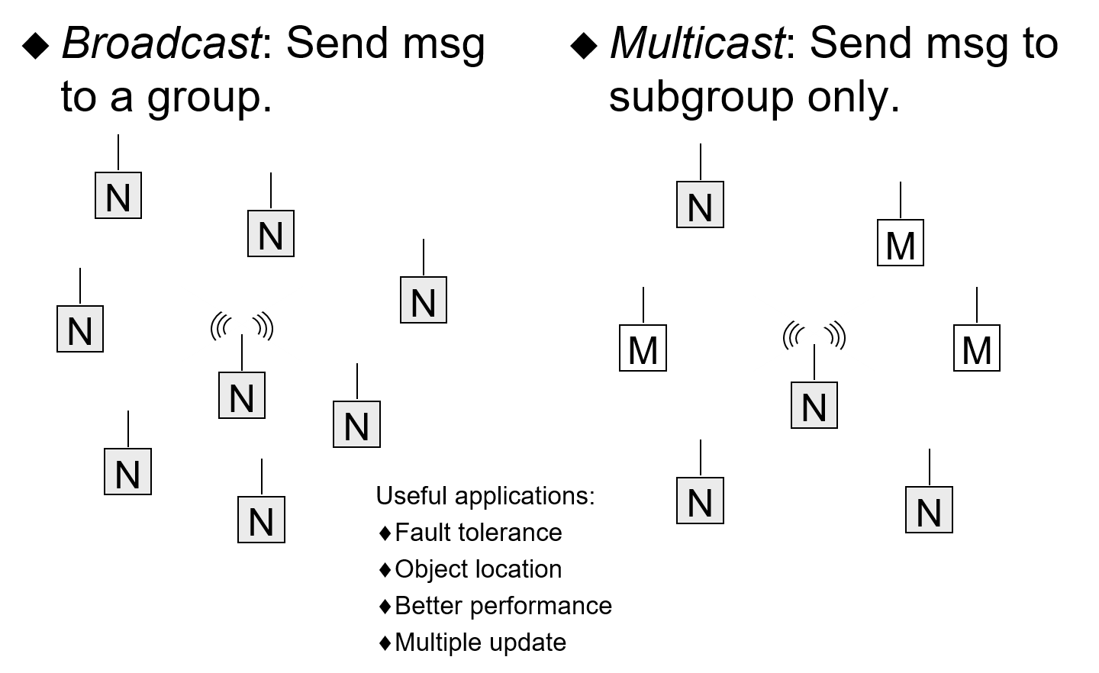
Group Communication
Notes:
Broadcast and multicast are similar: one sends message to a group, and the other send message to a subgroup.
Multicast messages are a very useful tool for constructing distributed systems with the following characteristics:
Fault tolerance based on replicated services
Locating objects in distributed services
Better performance through replicated data
Multiple update

Slide 34
Event Management
Event management service defines interfaces for different group communication models.
Events are created by suppliers (producers) and communicated through an event channel to multiple consumers.
Service does not define a quality of service (left to implementers).
Notes:
Many systems nowadays provide event management service. The one presented here is based on the OMG/CORBA architecture, where group communication for multicasts are supported on top of standard CORBA operation invocation requests. This support is provided as part of the CORBA services architecture within the event management service.
Consequently, the service exports a number of interfaces and operations. This specification is included as an appendix to these notes.
The service identifies three different roles. Event producers create events that are to be multicasted to consumers. An event channel acts as a mediator between these two so that producers and consumers are anonymous and do not know each other. The advantages of an event channel:
Support communications for any number of suppliers and consumers in connection with a given type of event.
Events can be buffered to allow for consumers of different speeds.
The events can be persistently stored by the Event Channel to ensure that events are not lost on system failures. The stored event can be transactional (updates depend on commits/aborts).
Support push/pull consumers/suppliers.
The service specification, however, does not include any guidelines for quality of services. This is left to the companies who produce event management service implementations.

Slide 35
Push Model
Consumers register with the event channels through which the events the consumers are interested in can be communicated.
Event producers create a new event by invoking a push operation from an event channel.
Event channel notifies all registered consumers by invoking their push operations.
Notes:
There are two different models of event communication in the CORBA event management: a push and a pull model. They differ in who takes the initiative to get a group communication started. The flow of information is in both cases from producers to consumers.
In the CORBA approach of multicasting, event channels are the mechanism to identify the subgroup of event consumer objects that are to be notified about a certain event. Event consumers therefore register with those event channels that correspond to events they are interested in.
Events are created by event producers. To do so, they request a push operation execution from the event channel and pass the event parameters as parameters of that push operation.
The event channel then requests all the event consumers that are currently registered to execute a push operation and passes the parameters it had earlier received from the producer.

Slide 36
Push Model (Example)
Share value updated
Redisplay chart
Redisplay table
Event Channel
Producer
Consumer
Consumer
push(...)
push(...)
push(...)
Notes:
As an example, consider an application that displays the change of share values during trading at a stock exchange.
This is a distributed system because brokers are located all over the City and also brokers in Hong Kong, New York and Tokyo might be interested in what´s going on in the London stock exchange.
Whenever a deal is agreed, a share object changes its value to take the last deal into account. Then all applications on broker´s displays have to be updated to reflect the share´s new value.
This can be implemented with CORBA event management:
Shares are represented as CORBA objects and they have operations with which the stock exchange´s trading system can modify their values.
An event channel object is maintained for each share object. Applications that display the current value of a share object register as consumers with the event channel associated to that share object to be informed about ongoing trade in the share.
Whenever the stock exchange´s trading system updates the value of the share, the share object (as an event producer) pushes the new share value together with related information (such as volume of the deal and the time the deal was closed) into the event channel.
The event channel then forwards this information to all applications that are registered and invokes their push operation together with additional event parameters.

Slide 37
The Pull Model
Event producer registers its capability of producing events with event channel.
Consumer obtains event by invoking pull operation from event channel.
Event channel asks producer to produce event and delivers it to the consumer.
Notes:
In the pull model initiative starts from the consumer. The consumer asks the event channel about a new event and the channel has to know who is capable of producing it.
Event producers, therefore, register with event channel and declare that they are capable of producing events.
The control flow is then exactly the other way around as in the pull model. Consumer objects ask the event channel to deliver an event.
The event channel then asks the producer to create an event which is then delivered to consumers.
This in its pure form is not yet a group communication, but rather an anonymous request where the event channel acts as a broker between consumer and producer.
However, the pull and the push model can be combined, so that the event channel after having received the event from the producer communicates it to all consumers so that they all have up-to-date information.

Slide 38
Pull Model (Example)
Current
value: 76.10
Current share value?
Event Channel
Producer
Consumer
Consumer
pull(...)
pull(...)
Notes:
To continue the share value display application, in a pull model, one consumer would ask the event channel about the current value of a share, by invoking the pull operation of the channel.
The event channel would then invoke the pull operation from the producer to obtain the current value.
The producer would pass that as an out parameter of the pull operation and the event channel would do the same.
In the combined model, the event channel would then also inform the second consumer about the current value by invoking its push operation.

Slide 39
Event Channel
Push consumer
Push supplier
Event Channel
Direction of event transfer
Supported combinations:
push suppliers, push consumers
push suppliers, pull consumers
pull suppliers, push consumers
pull suppliers, pull consumers
Pull supplier
Pull consumer
Notes:
Event Channel supports all four different combinations.
Push suppliers, push consumers: the suppliers push events to the Event Channel, which in turn pushes them to the consumers.
Push suppliers, pull consumers: the suppliers push events to the Event Channel, and each pull consumer pulls an event when it is ready to process it.
Pull suppliers, push consumers: the Event Channel pulls events from the suppliers, and then it pushes these tot he consumers.
Pull suppliers, pull consumers: the consumers pull event from the Event Channel, which in turn pulls them from the suppliers.

Slide 40
Event Channel (with proxies)
Proxy push consumer
Proxy push supplier
Push consumer
Push supplier
Event Channel
Direction of event transfer
Proxy pull consumer
Proxy pull supplier
Pull supplier
Pull consumer
Notes:
A push supplier expects to make calls to push() on a PushConsumer object (see Appendix): this object is provided within the Event Channel, and is refereed to as a proxy push consumer.
A pull consumer expects to make calls to the pull() and try_pull() operations on a pull supplier object: this object is provided within the Event Channel, and is referred to as a proxy pull supplier.
A pull supplier expects to have a pull consumer make calls to its pull() operation: the Event Channel provides this object, a proxy pull consumer, to make these calls.
A push consumer expects to have a push supplier make calls to its push() operation: the Event Channel provides this object, a proxy push supplier, to make these calls.

Slide 41
Homework
A client sends a 200 byte request message to a service, which produces a response containing 5000 bytes. Estimate the total time to complete the request in each of the following cases, with the performance assumptions listed below:
i) Using connectionless (datagram) communication (for example, UDP);
ii) Using connection-oriented communication (for example, TCP);
iii) The server process is in the same machine as the client.
[
Latency per packet (local or remote, incurred on both send and receive): 5 milliseconds
Connection setup time (TCP only): 10 milliseconds
Data transfer rate: 10 megabits per second
Maximum Transfer Unit (MTU): 1000 bytes
Server request processing time: 2 milliseconds
Assume that the network is lightly loaded, so network delays are ignored.
In the same machine: the messages can be sent by a single in memory copy, where inter-process data transfer rate is at 40 megabits/second.
]

Slide 42
Projects
自由命题：
利用所学的并行或分布式计算的技术，解决一些实际问题如：如影片、音乐、图片等推荐问题、大规模数据的预测问题、数据挖掘问题等；
可选命题：
1、利用MapReduce编程模型实现推荐系统（公开数据集、协同过滤算法）；
2、利用MPI实现并行的深度优先搜索算法 （公开数据集）；
3、利用MPI + OpenMP算法实现大数据集特征抽取 （公开数据集）；
4、基于GPU+LSTM的时间数据预测问题 （公开数据集）

Slide 43
Thank You !

